Slide 1





Neutrons and Li-ion batteries:
A perfect marriage
Matteo Bianchini
LRCS
Christian Masquelier (LRCS),
Laurence Croguennec (ICMCB),
Emmanuelle Suard (ILL)
ICMCB
ILL
Notes:
These sur financement ILL

Slide 2
Summary:
Neutron Diffraction Experiments In Real Time
Introduction: Li-ion batteries, why neutrons and why operando ?
A new Electrochemical cell to study Li-ion battery materials
How ?
Spinel materials:
Li_{1+x}Mn_{2-x}O₄
LiNi_{0.4}Mn_{1.6}O₄
Applications
Conclusion

Slide 3
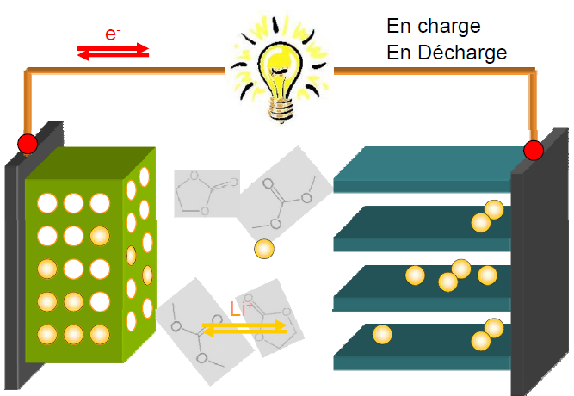
Working principle of Li-ion batteries
Discharge
Reduction
Li¹⁺Fe²⁺ (PO₄)³⁻
Fe³⁺ (PO₄)³⁻
Positive Electrode
LiFePO₄
Separator/Electrolyte
EC:DMC - LiPF₆
Negative Electrode
Graphite
Notes:
STRESS on structural evolution

Slide 4

The Goal: Diffraction in real time…
In situ & Operando
Notes:
The first and most challenging point has been to develop…

Slide 5
The Goal: Diffraction in real time…
In situ & Operando
Electrode materials studied ex situ risk to be exposed to atmospheric agents (even in gloveboxes)
Electrochemical reactions are dynamical processes
Metastable phases are often encountered
High-rate cycling means non-equilibrium conditions
Operando studies reproduce as much as possible
real-battery working conditions
Notes:
The first and most challenging point has been to develop…

Slide 6
The Goal: Diffraction in real time…
In situ & Operando
…with neutrons
An electrochemical cell for
In Situ NEUTRON DIFFRACTION
good electrochemical performances
REFINABLE neutron diffraction (ND) powder patterns
Notes:
The first and most challenging point has been to develop…

Slide 7
Neutrons: Challenges vs. Why do we care?
  Neutrons’ sensitivity to Lithium!
  Neutrons’ contrast between neighbouring elements
  Neutrons probe the whole electrode
MAIN ISSUES | ND | Electrochem. | Solution
amount of powder required | > 120 mg | < 250 mg | 200 mg
hydrogen-rich electrolytes | High backgound | OK | Deuterated Electrolytes (costly)
Neutron scattering lengths
Notes:
There are a number of issues related to the use of neutrons
ONLY SAY QUICKLY DEFECTS
-big electrodes to sample
-h scatters neutrons incoherently

Slide 8
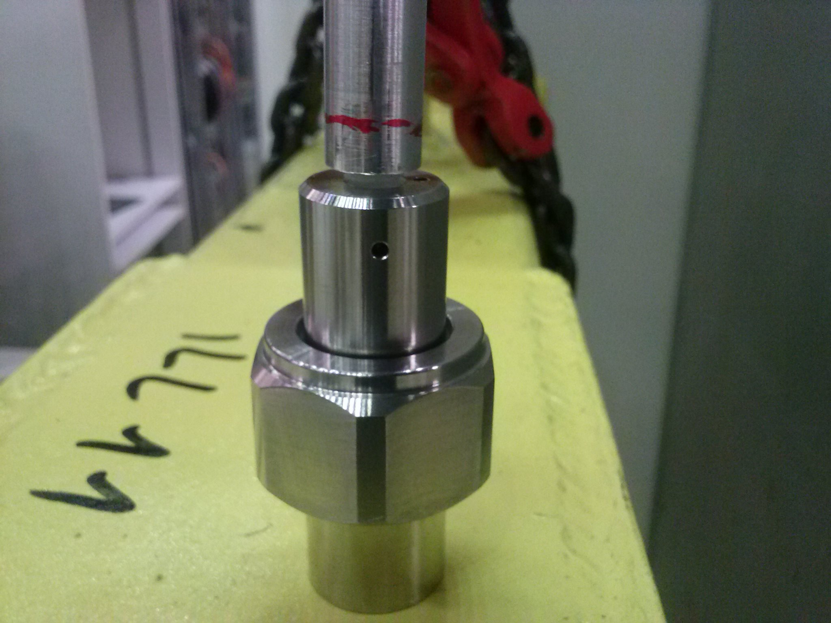
A new electrochemical cell for in situ neutron diffraction
Plunger
Mylar foil
Spring
TiZr current collector
Li metal (negative electrode)
Separator
Gasket
TiZr container
Powder (positive electrode)
M. Bianchini, J.B. Leriche, J.-L. Laborier, , L.Gendrin, E.Suard, L. Croguennec, C.Masquelier, J. Electrochem. Soc., 160(11), A2176, 2013
A new Null Matrix electrochemical cell for Rietveld refinements of in situ or operando neutron powder diffraction data
Notes:
CAREFUL: TIZR!!!!! Neutron transparent! And good conductor and resist oxydation and chemical corrosion
IMPORTANCE OF D20 AS WELL

Slide 9
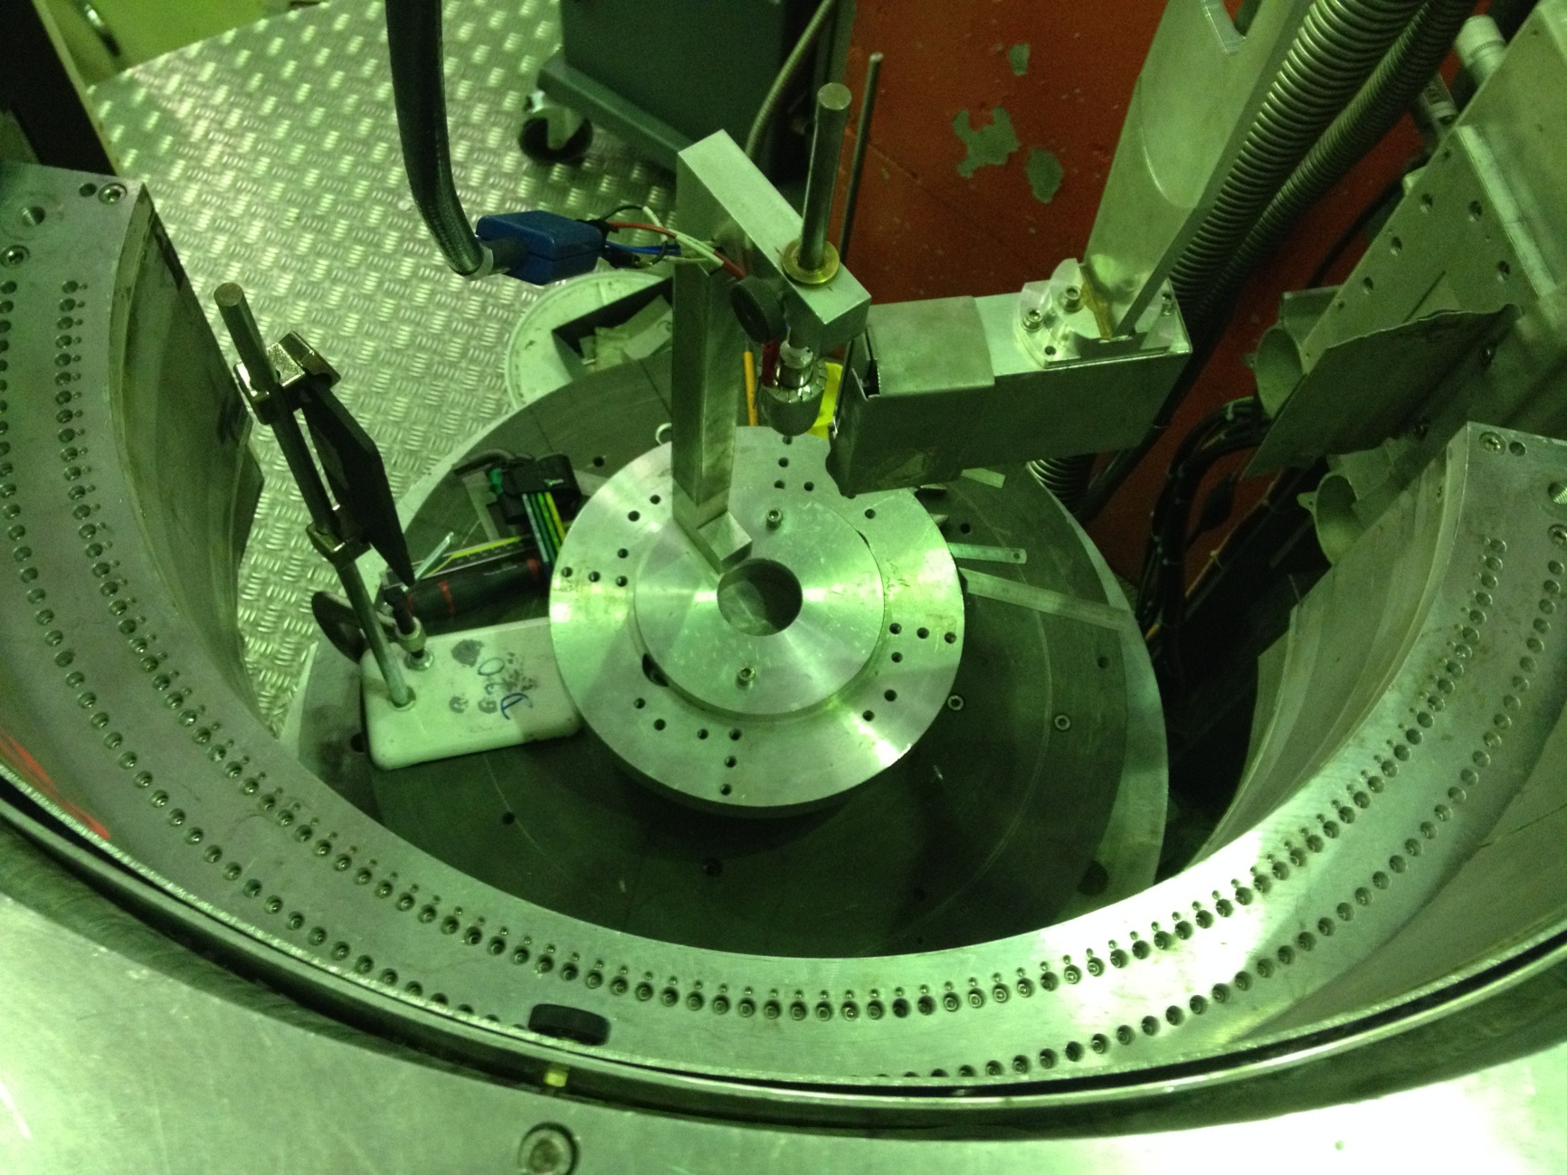
D20 @ ILL (High Flux) – Experimental Setup
Potentiostat‘s
connections
In situ
Cell
Neutrons beam
Detector
Notes:
Position sensitive detector

Slide 10
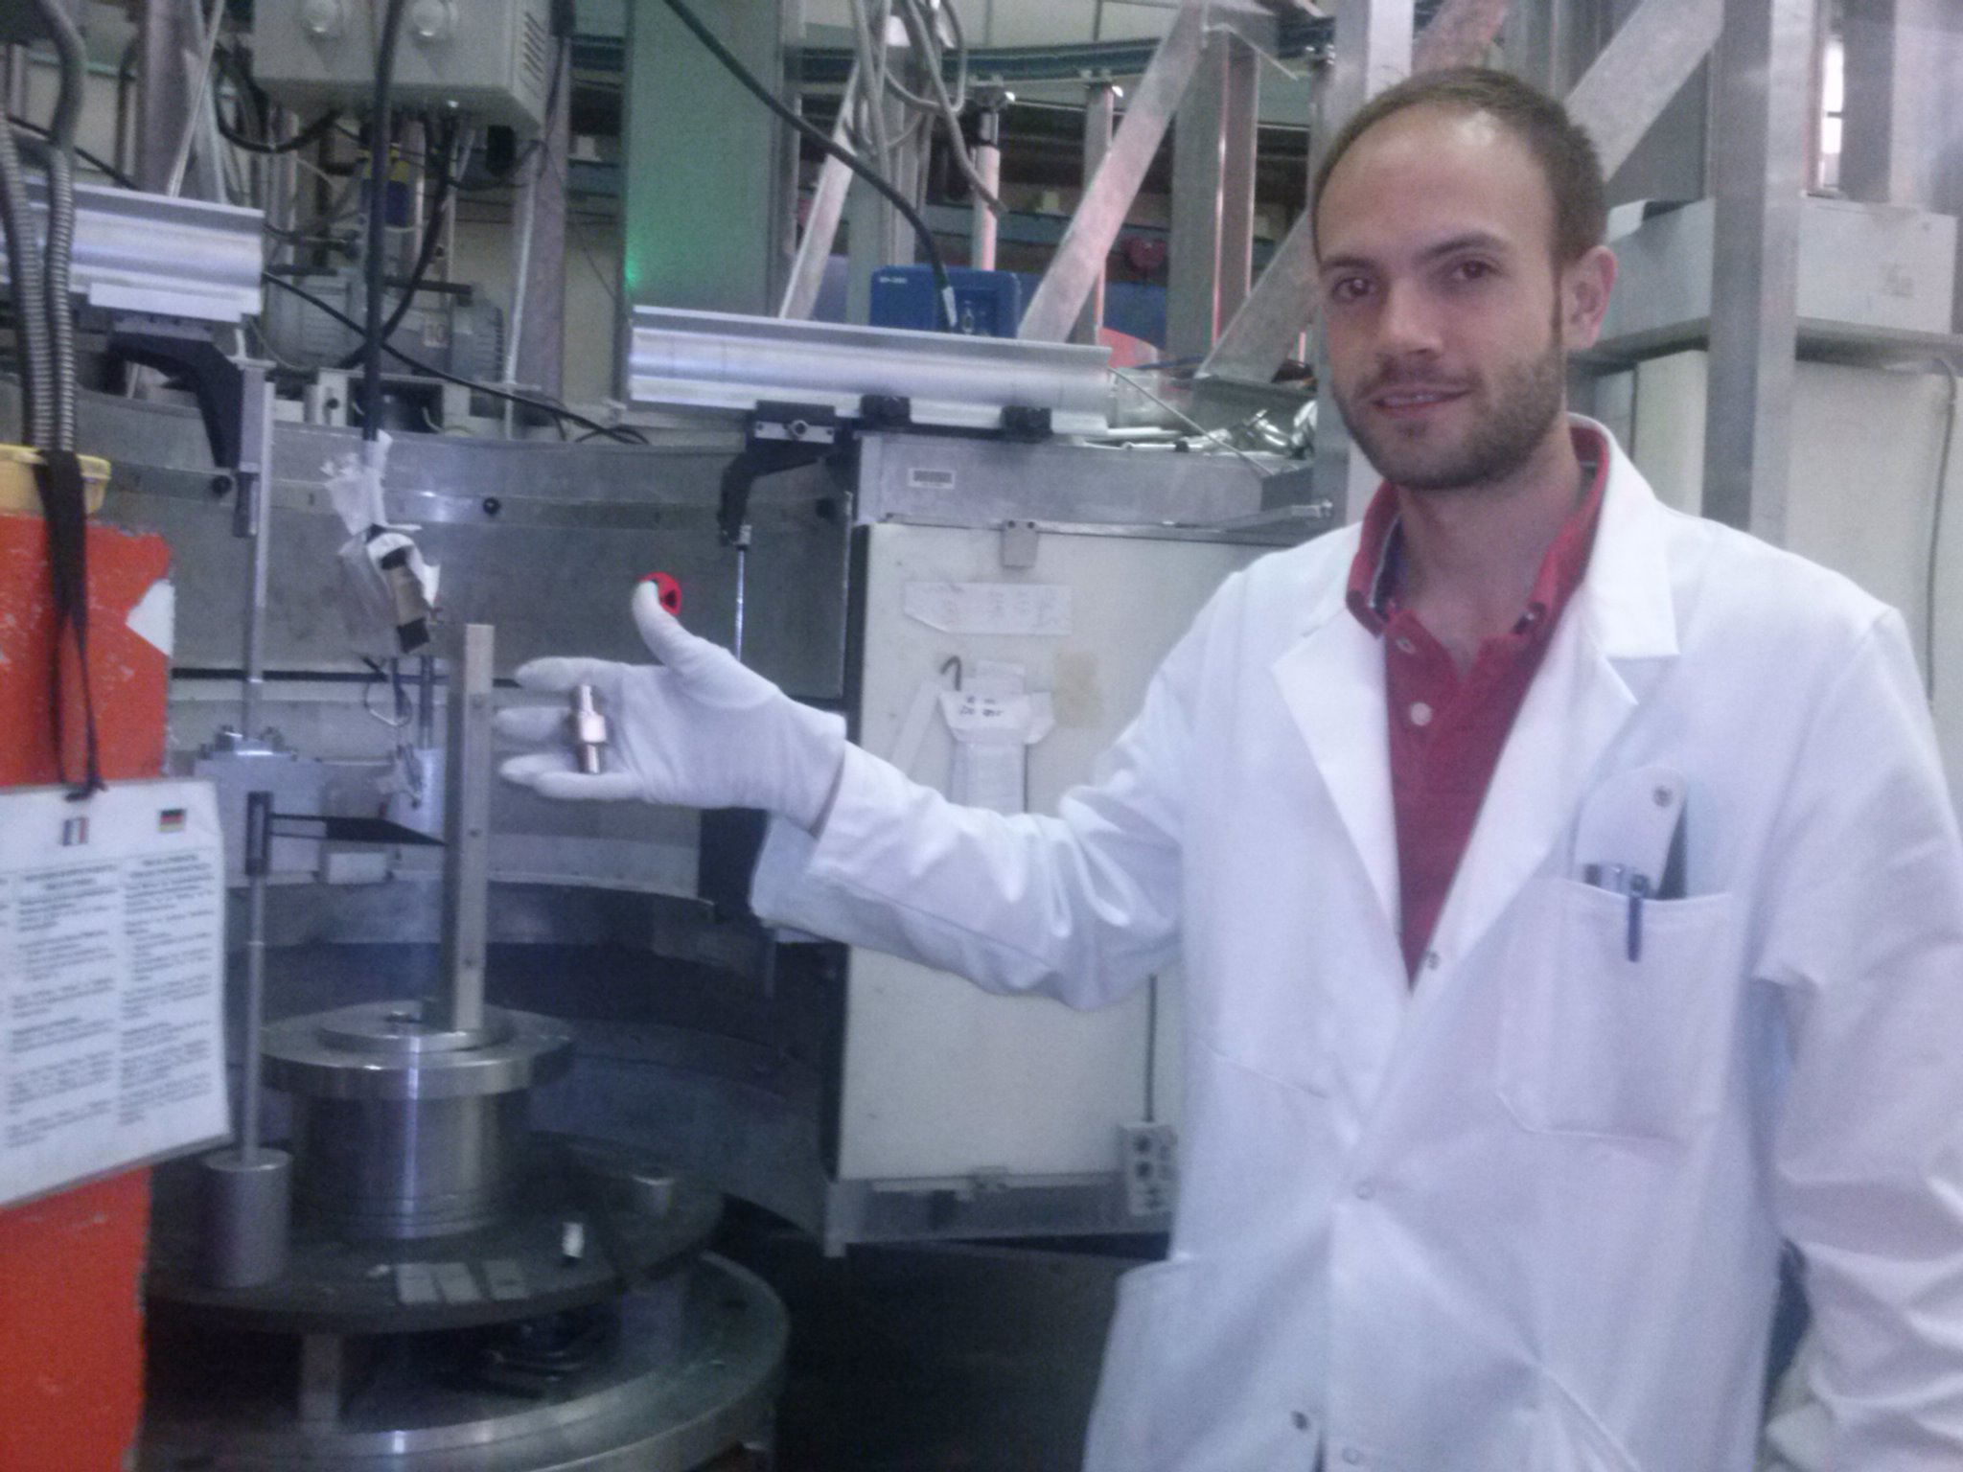

Slide 11
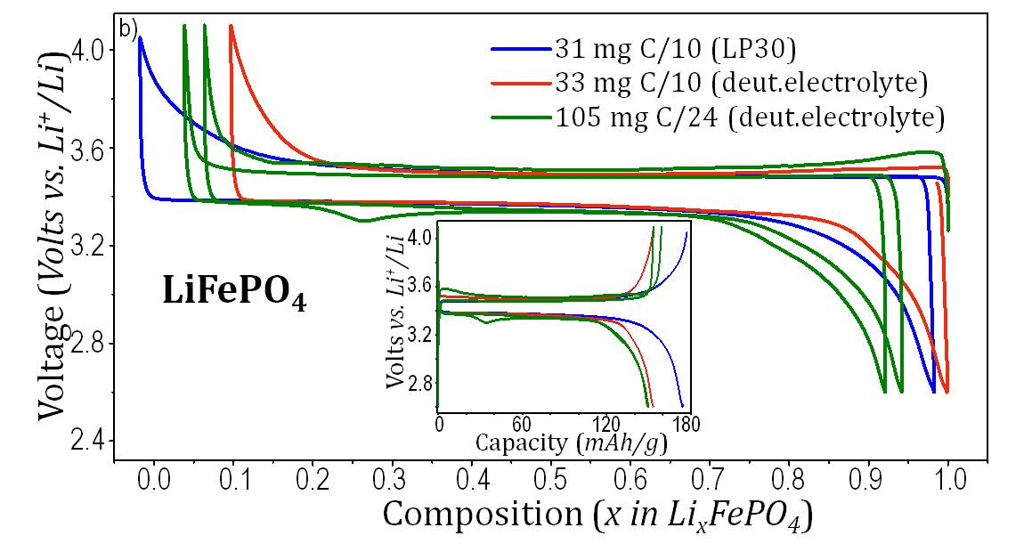
D2B λ=1.594Å, T=298K
LiFePO₄ powder
Cell Validation: LiFePO₄
Pnma
a=10.3233(2) Å
b=6.0044(1) Å
c=4.6918(1) Å
LiFePO₄ POWDER
measured on D2B
LiFePO₄ in the in-situ cell,
in a full-battery configuration,
measured on D20
D20 λ=1.547Å, T=298K
In-situ: LiFePO₄+C_{sp} // electrolyte
36
39
42
54
57
60
63
20
40
60
80
100
120
140
Galvanostatic cycling
2θ (°)

Slide 12
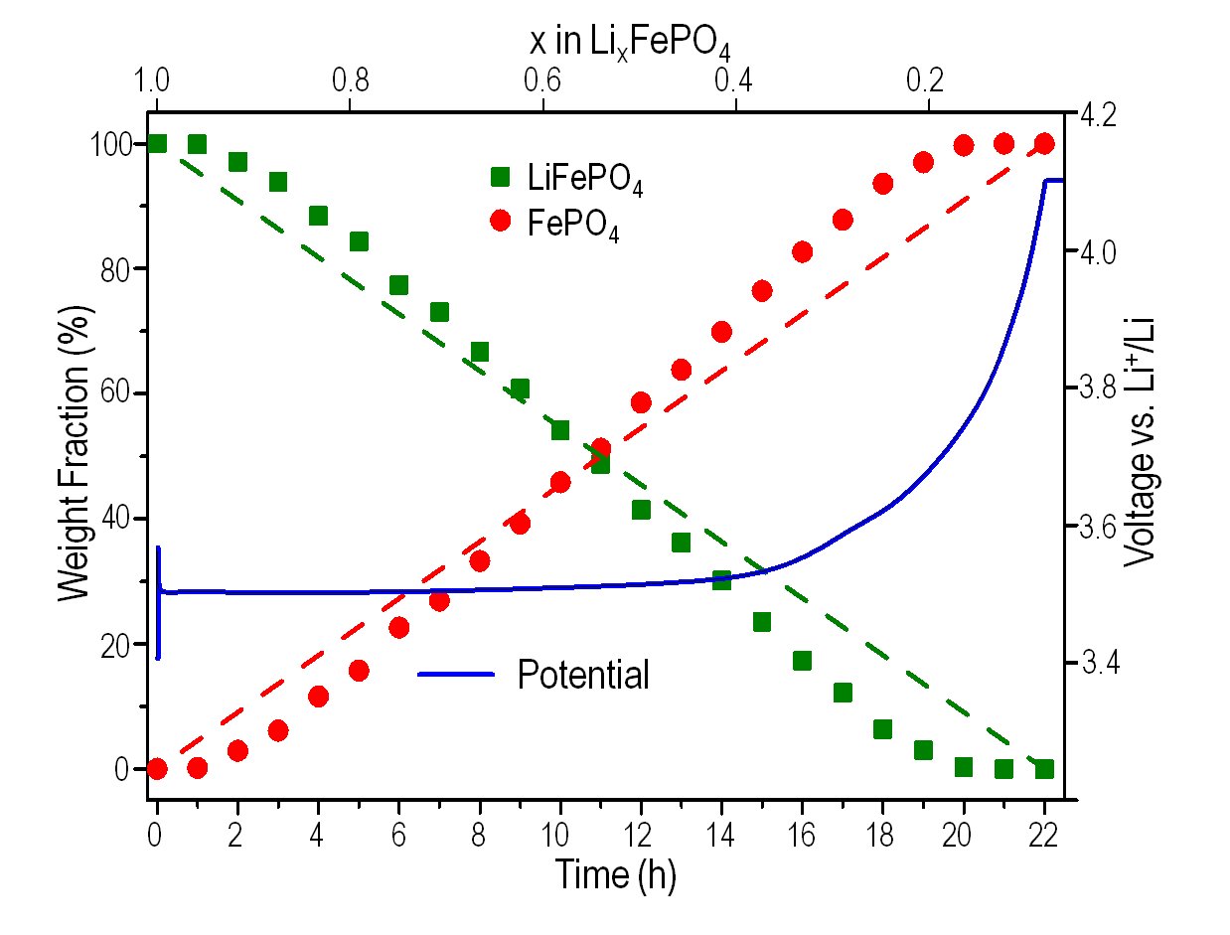
In-situ ND of a LiFePO₄ battery
LiFePO₄
C/24
24
20
16
Intensity (a.u.)
Time (h)
12
8
4
0
30
40
50
60
70
80
90
4.2
3.9
3.6
2θ (°)
Voltage vs. Li⁺/Li
Intensity (a.u.)
Rietveld
refinement
30
35
40
2θ (°)

Slide 13
Applications: LiMn₂O₄ positive electrodes
After Cell Validation using well-known battery materials
Cubic LiMn₂O₄
Li_{1+x}Mn_{2-x}O₄
(or [Li]_{Td}[Li_{x}Mn_{2-x}]_{Oh}O₄)
Capacity
fading
Smaller capacity
BUT NO capacity fading
A set of 3 samples:
LiMn₂O₄
Li_{1.05}Mn_{1.95}O₄
Li_{1.10}Mn_{1.90}O₄
M. Bianchini, E. Suard, L. Croguennec and C. Masquelier, Journal of Physical Chemistry C (2014), 118(45), 25947
M. Bianchini, J. B. Leriche, J.-L. Laborier, L. Gendrin, E. Suard, L. Croguennec and C. Masquelier, J. Electrochem. Soc. (2013), 160 (11), A2176.
Notes:
Chute rapide du potentiel

Slide 14
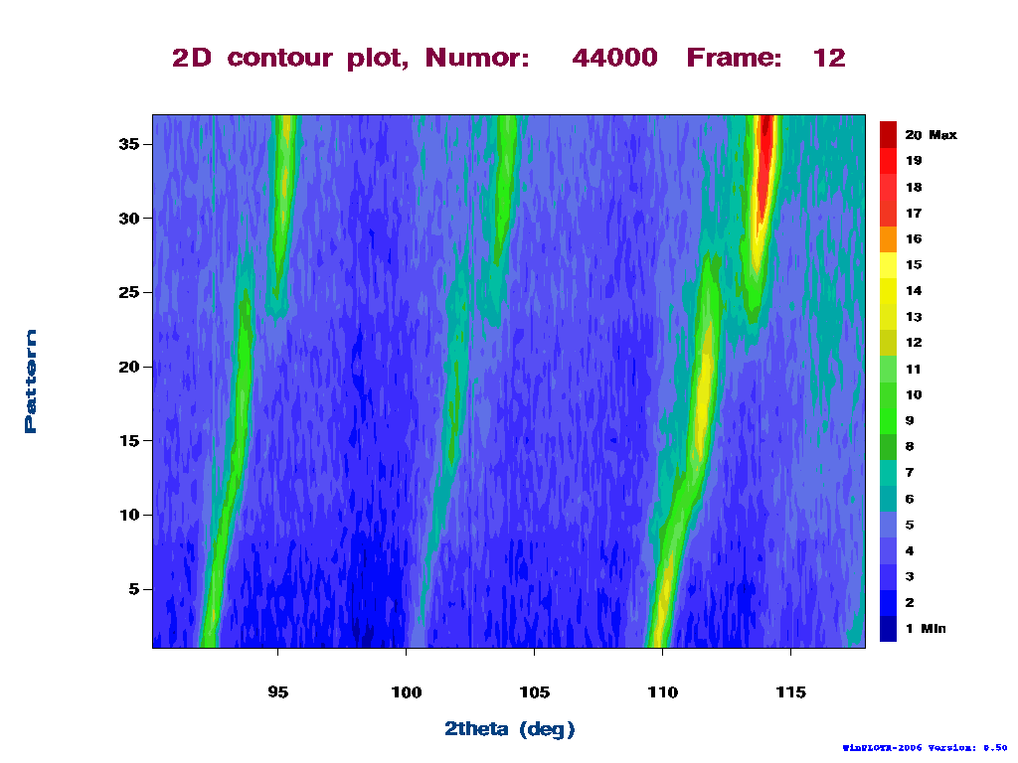
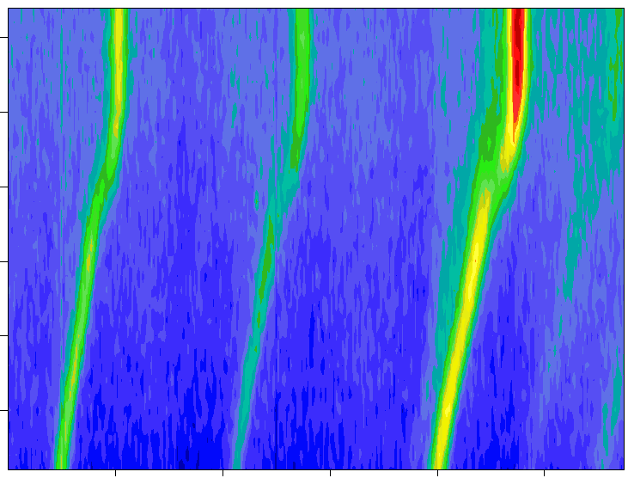
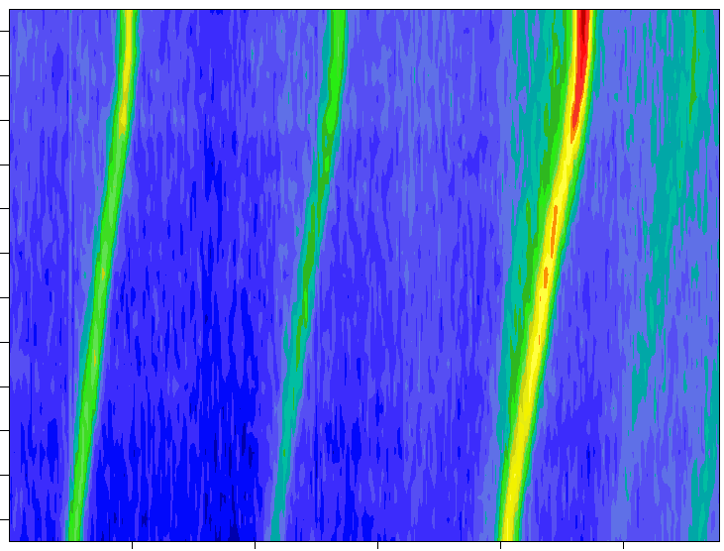
Electrode charge (C/20) in real-time
35
LiMn₂O₄
30
25
Peak Intensity
Scan number = Time(h)*2
20
Charge
15
10
5
Li_{1.05}Mn_{1.95}O₄
0
95 100 105 110 115
Li_{1.10}Mn_{1.90}O₄
2θ (°), λ=1.547 Å
30
24
25
20
20
16
Scan number = Time(h)*2
Scan number = Time(h)*2
Charge
Charge
15
12
10
8
5
4
0
0
95 100 105 110 115
95 100 105 110 115
2θ (°), λ=1.547 Å
2θ (°), λ=1.547 Å
Notes:
Diagramme 2D
Domain de miscibilité

Slide 15
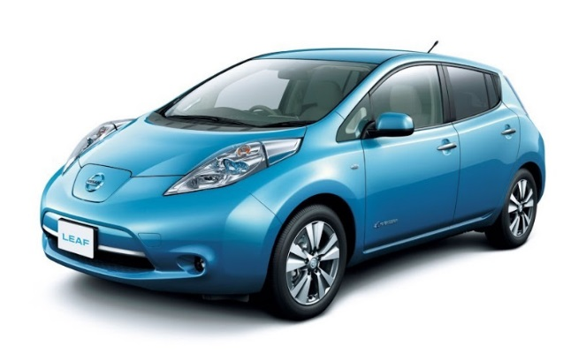
Electrode charge (C/20) in real-time

Slide 16
High-Voltage spinel materials: LiNi_{0.4}Mn_{1.6}O₄

Slide 17
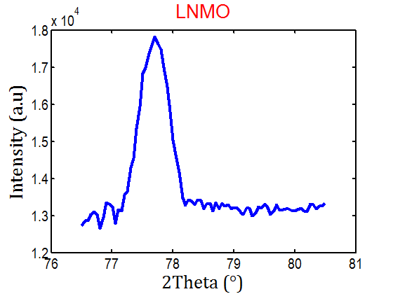
High-Voltage spinel materials: LiNi_{0.4}Mn_{1.6}O₄

Slide 18
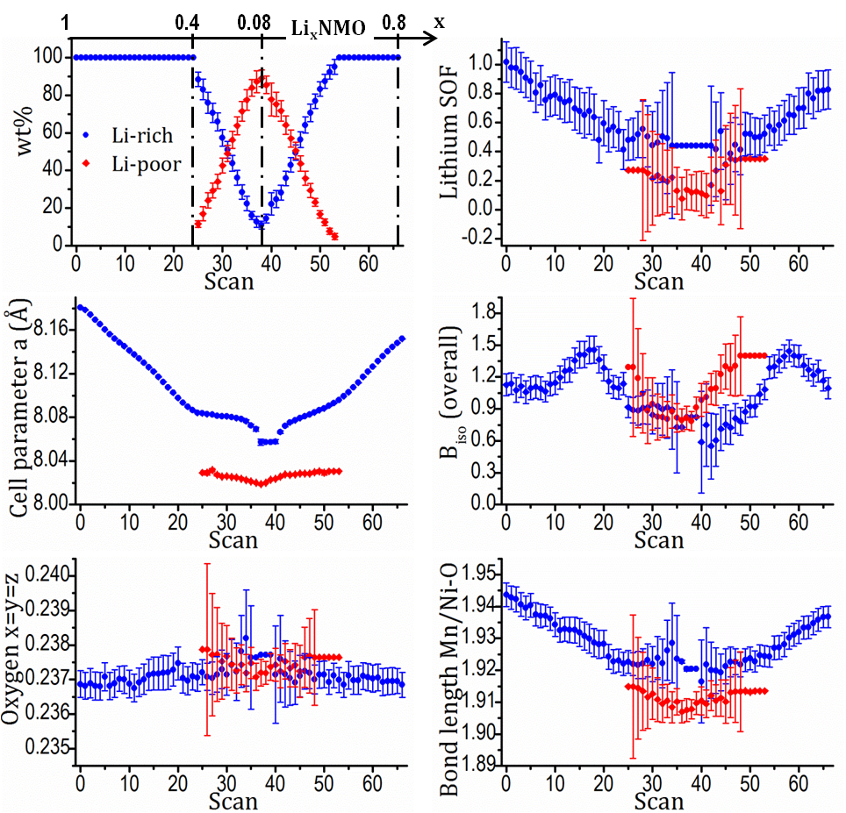
High-Voltage spinel materials: LiNi_{0.4}Mn_{1.6}O₄

Slide 19
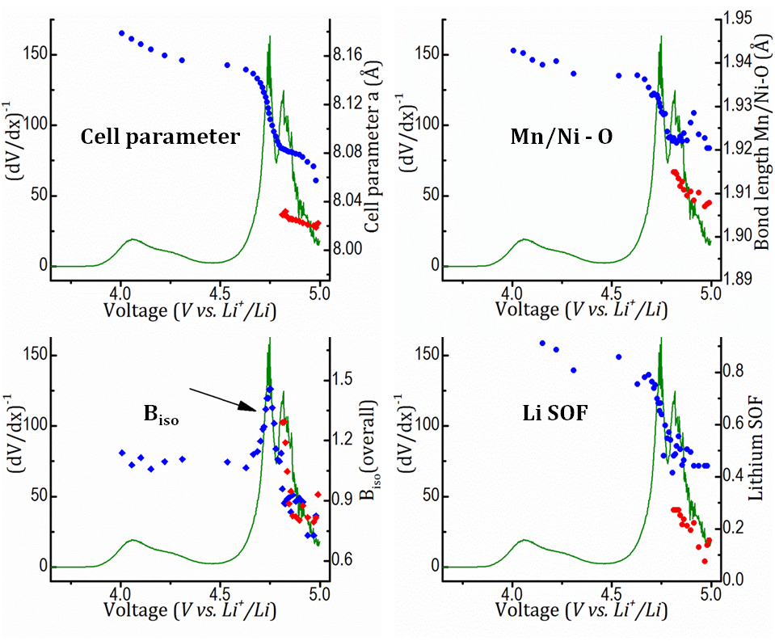
High-Voltage spinel materials: LiNi_{0.4}Mn_{1.6}O₄

Slide 20
Conclusions (1st part):
  Design of the (Ti,Zr) electrochemical cell
  Commercial electrodes were used for characterization
  First real study (spinels Li_{1+x}Mn_{2-x}O₄)
  Study of High-Voltage spinels LiNi_{0.4}Mn_{1.6}O₄
ND gives unique insight on lithium’s
crystallographic information and dynamics

Slide 21
Summary and Conclusion
X-Rays / Synchrotron
& Neutrons Diffraction
In Situ / Operando
& Ex Situ
Crystal structure ↔ Electrochemical properties of electrode materials
Better Li-ion and Na-ion batteries…
(…hopefully)

Slide 22
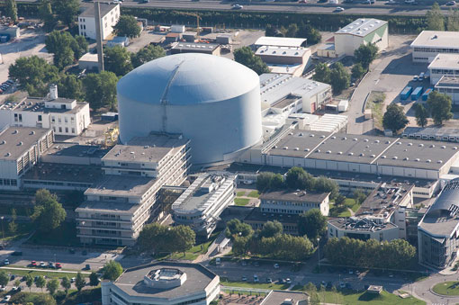
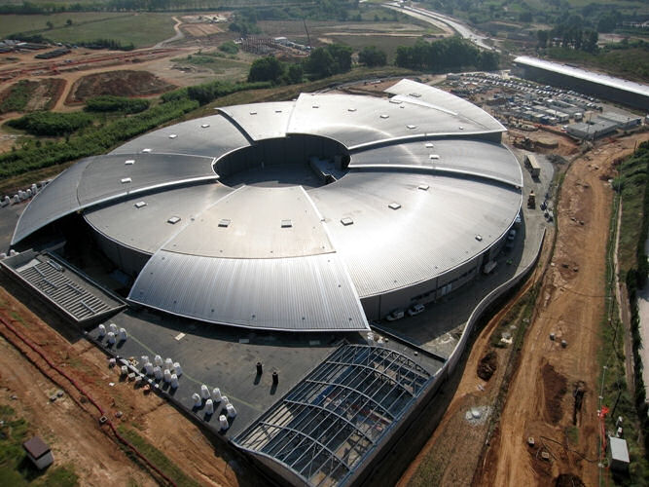
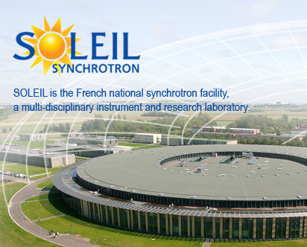
Acknowledgements
My supervisors:
Christian Masquelier (LRCS)
Emmanuelle Suard (ILL)
Laurence Croguennec (ICMCB)
My collaborators & everyone who helped me:
Nicolas Brisset (ICMCB)
Philippe Dagault (ICMCB)
François Fauth (ALBA)
François Weill (ICMCB)
Erik Elkaim (SOLEIL)
Jean Noel Chotard (LRCS)
Mathieu Morcrette (LRCS)
Helmut Schober (ILL)
Laurent Chapon (ILL)
Henry Fisher (ILL)
Pierre Bordet (CNRS)
Elena Bogdan (ICMCB)
Dany Carlier (ICMCB)
Yue Deng (LRCS)
Juan Rodriguez-Carvajal (ILL)
Jean Marcel Ateba-Mba (ICMCB)
Jean Bernard Leriche (LRCS)
Ludovic Gendrin (ILL)
Jean-Luc Laborier (ILL)
Thomas Hansen (ILL)
Fabien Lalere (LRCS)
Thibault Broux (ICMCB)
ILL, Grenoble
ALBA, Barcelona
SOLEIL, Paris

Slide 23
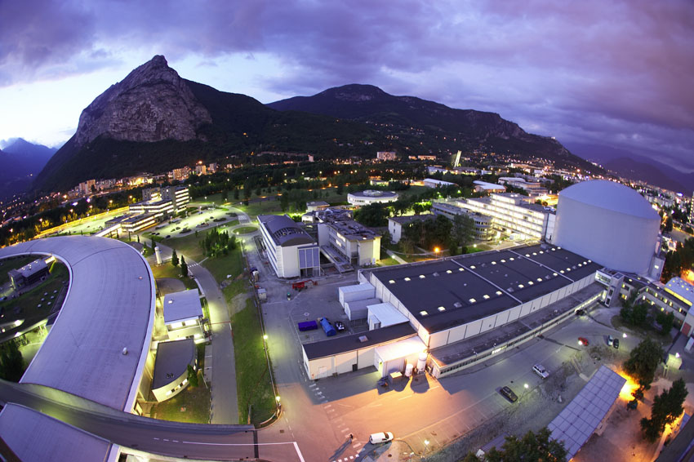
Thank you for your attention!
ILL is acknowledged for financial support and beamtime

